Slide 1
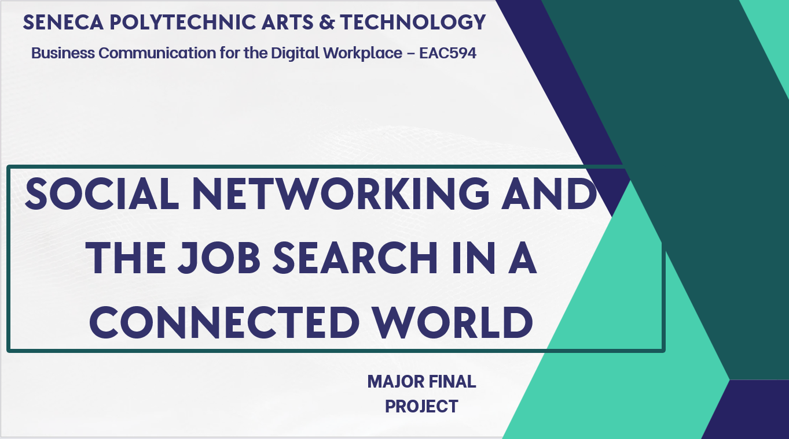

Slide 2
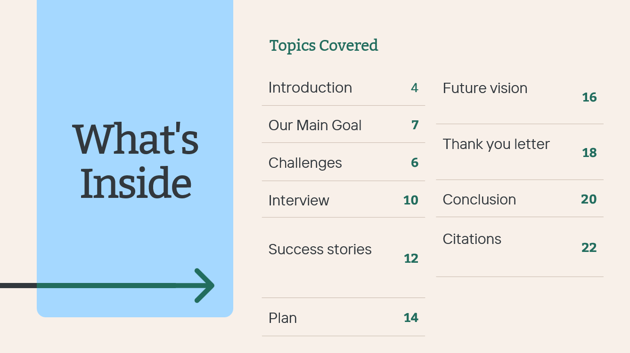

Slide 3

Introduction
April 2025
Job Searching in a Connected World: The Role of Social Networking in Web Development

Slide 4

April 2025
The digital age has transformed how we find and apply for jobs.
Traditional resumes are no longer enough, employers seek proof of skills and engagement.
In web development, showcasing expertise through online platforms is key.
Personal branding through social media, portfolio sites, and professional networking can give job seekers a competitive edge.
“Your brand is what people say about you when you're not in the room.” – Jeff Bezos

Slide 5
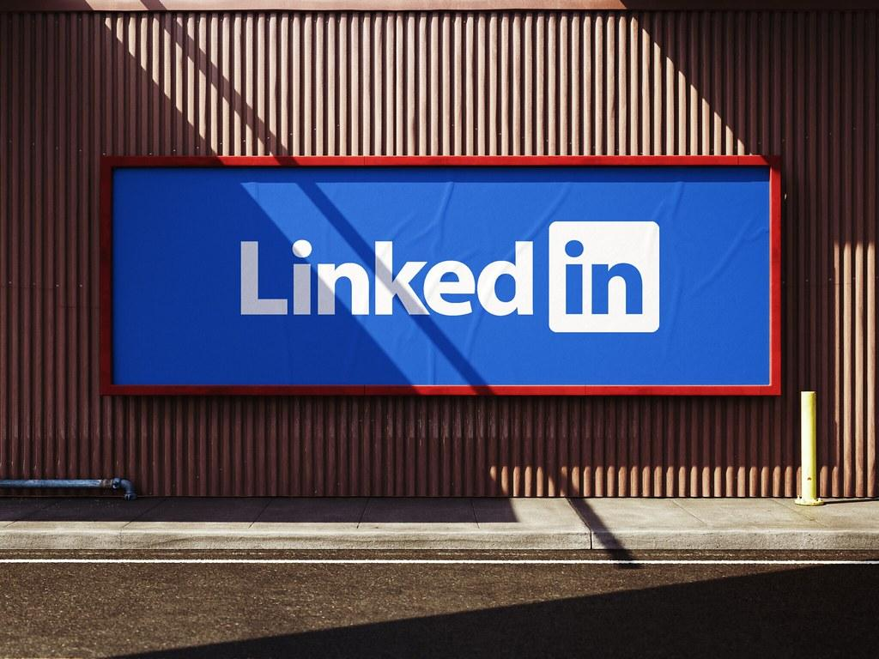





April 2025

Slide 6

OUR MAIN GOAL
For our final assignment, our group will explore effective social networking and job search strategies tailored for professionals in the IT sector. We will develop a personal branding strategy, investigate various social networking tools, and analyze success stories within our field to inform our proposals.

Slide 7

Challenges
April 2025
Obstacles in the Modern Job Market for
Web Developers

Slide 8

April 2025
Oversaturated Market: Thousands of new developers graduate each year—how do you stand out?
Lack of Visibility: Without an online presence, even talented devs go unnoticed.
Recruiter Fatigue: Recruiters filter candidates using keywords, LinkedIn profiles, GitHub activity, and more.
Evolving Platforms: Social media platforms frequently update algorithms—strategies that worked yesterday might not work today.
Scams and Misinformation: Unverified job posts and fake recruiters are common, especially on platforms like WhatsApp, Telegram, and Facebook.
“Challenge = Opportunity to Innovate with Personal Branding”

Slide 9

Interview
April 2025
Professional Insights: Networking in
Web Development

Slide 10

April 2025
Interviewee: Mr. Hasan Rahman, Full-Stack Developer @ TechHive
Importance of Online Portfolio: “If you’re not showcasing your work online, you’re invisible.”
Top Platforms He Uses: GitHub, LinkedIn, Stack Overflow, and Dev.to
Networking Tip: “Engaging in community discussions helped me connect with employers directly.”
Advice to New Developers:
Contribute to open-source projects.
Write blog posts or create tutorials.
Keep LinkedIn updated with a clear
summary and featured work.
Ask for endorsements and give them in return.
“Networking isn’t about collecting contacts, it’s about building relationships.”

Slide 11

Success Stories
April 2025
Success Stories in Web Development

Slide 12
April 2025
1. Charlotte Rinaldi
Expertise Through Consistency
2. Jennifer Saxon
Networking for Career Growth
3. Kathleen Lee
Adapting Personal Branding Over Time
Story: Charlotte Rinaldi emphasized the importance of consistency in her personal brand. By maintaining a professional and focused online presence, she positioned herself as an expert in her field. This approach made her a go-to person for her niche, improving her career prospects significantly.
Key Takeaway: Consistency and professionalism in personal branding can attract opportunities and establish credibility
Story: Jennifer Saxon leveraged her network to build a strong personal brand. By actively engaging with professionals in her industry and showcasing her skills through social media, she created opportunities for career advancement.
Key Takeaway: Networking combined with a well-defined personal brand can open doors to new job opportunities
Story: Kathleen Lee highlighted the importance of adapting her personal brand as she gained new skills and experiences. Her evolving brand reflected her growth, which helped her secure roles that aligned with her career aspirations.
Key Takeaway: A dynamic personal brand that evolves with your career can demonstrate growth and attract better opportunities

Slide 13

Plan
April 2025
Personal Branding Strategy for
Web Developers

Slide 14
April 2025
Build a Portfolio Website
Showcase projects, blogs, certifications, and contact info.
Write Technical Blogs
Use platforms like Dev.to, Medium, or your own site.
Maintain GitHub Activity
Pin top projects and contribute to open source.
Engage in Developer Communities
Twitter (#CodeNewbie, #100DaysOfCode), Reddit, Stack Overflow, Discord.
Optimize LinkedIn Profile
Add a custom banner, short summary, and list your skills.
Join Mentorship Platforms
Ten Thousand Coffees, MentorCity, ADPList.
“Make personal branding a habit, not a one-time effort.”

Slide 15

Future Vision
April 2025
The Future of Job Searching in
Web Development

Slide 16
AI-Curated Matches: Job portals recommending roles based on GitHub commits and blog content.
01
Portfolio as a Resume: Repositories, blogs, and videos becoming more relevant than PDFs.
02
Skill Verifications via Blockchain: Credential validation through decentralized networks.
03
Virtual Networking Events: More hiring through remote hackathons and Discord/Slack job fairs.
04
Niche Communities: Micro-communities (e.g., WomenWhoCode, IndieHackers) gaining more influence.
05
April 2025

Slide 17

Thank You Letter
April 2025
Appreciation Letter

Slide 18
April 2025
April 5, 2025
Mr. Hasan Rahman Senior Full-Stack Developer TechHive BD
Dear Mr. Rahman,
Thank you sincerely for taking the time to speak with us about the evolving nature of job searching in web development. Your practical advice and experiences were incredibly insightful and encouraging. We learned how critical it is to maintain a professional online presence and engage with the community to build meaningful career paths.
We appreciate your generosity and look forward to staying connected through LinkedIn.
Best regards, Md Asif Karim Computer Programming Seneca Polytecnic Arts & Technology

Slide 19
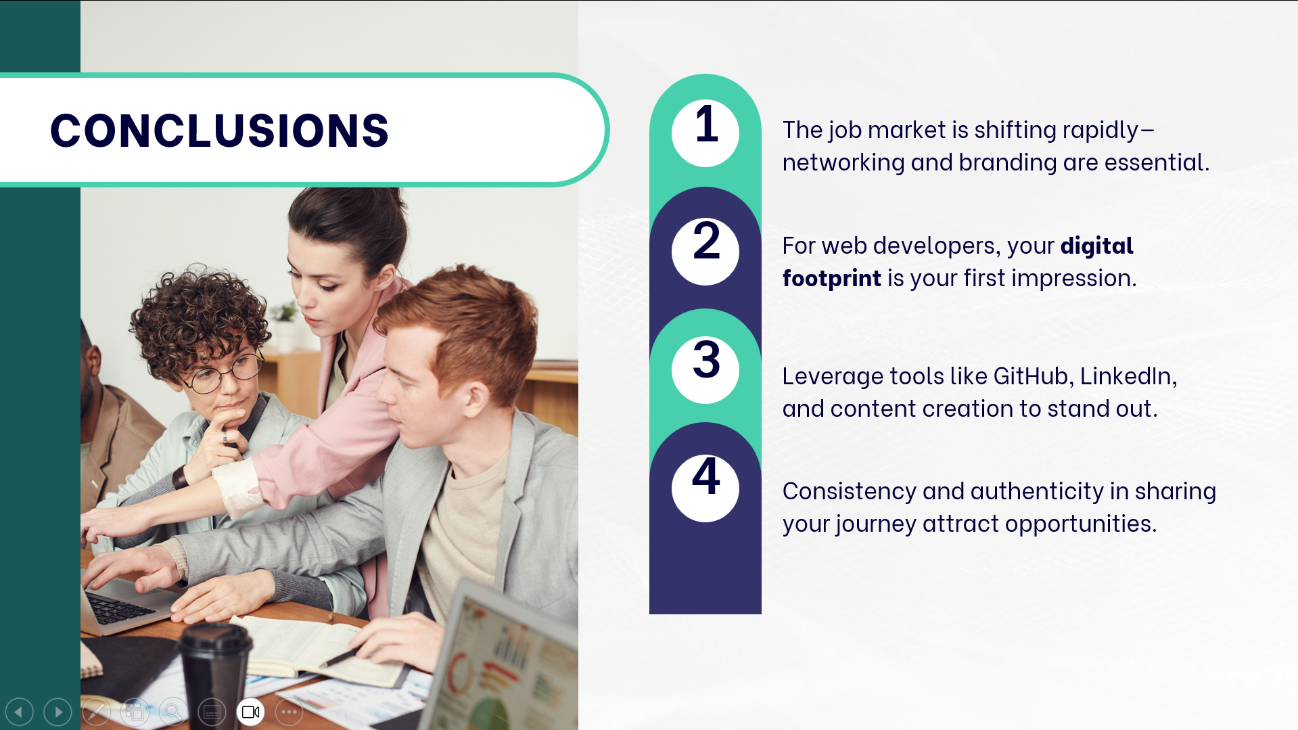

Slide 20

Citations
April 2025

Slide 21
April 2025
Coursey, E. (2024, November 21). 5 steps to building a strong personal brand that accelerates your job search. iHire. https://www.ihire.com/resourcecenter/jobseeker/pages/5-steps-to-a-personal-brand-showing-employers-who-you-are
Guiseppi, M. (2024, August 22). Twitter vs Linkedin for executive job search networking. Executive Career BrandTM. https://executivecareerbrand.com/twitter-vs-linkedin-executive-job-search/
How to use social media to your advantage when job hunting. (2023, September 15). University Canada West. https://www.ucanwest.ca/blog/education-careers-tips/how-to-use-social-media-to-your-advantage-when-job-hunting
Social media. WorkBC. Retrieved April 7, 2025, from https://www.workbc.ca/search-and-prepare-job/job-application-tips/social-media
Social media in your job search. (2015, August 27). Social Media in Your Job Search - School of Management - University at Buffalo, University at Buffalo. https://management.buffalo.edu/career-resource-center/students/networking/social-media/using.html
TalentAlly. (2025, January 30). Personal branding for job seekers: A beginner's guide. LinkedIn. www.linkedin.com/pulse/personal-branding-job-seekers-beginners-guide-talentallyatwork-0vxxc
TechDoQuest. (2025, February 25). How personal branding can set you apart in the job market. LinkedIn. www.linkedin.com/pulse/how-personal-branding-can-set-you-apart-job-market-techdoquest-jifwc
Picture from Unsplash

